Slide 1
Suma D
Suma.d@manipal.edu

Slide 2
Event Driven programming using java(CSE210)
Overview of java
Packages and interface
Exception handling
Multithreading
Input/output
Applet
Event handling
AWT
Database
Swings
servlets

Slide 3
Course objectives
Develop programs on Eclipse platform
Write simple programs using primitive data types, control statements classes methods etc.
Develop GUI
Develop applets
Write interesting java projects
Establishing firm foundation on java’s basic concepts

Slide 4
Java History
In 1991, Sun Microsystems set up a research project to develop a language for programming ‘intelligent’ consumer electronics
  e.g. video recorders, TVs, toasters
The language was called Oak (later changed to Java). Developed by James Gosling, and others.

Slide 5
August 1993: the project was cancelled after two commercial deals fell through.
The Web became popular during 1993.
July 1994: Sun restarted work on Java as a Web programming language.
  Java contains networking features, platform portability, and a small runtime system

Slide 6
Java released May 1995
  Netscape supported Java in Navigator 2.0, which gave it an enormous boost
May 1996: JDK 1.0 released.
February 1997: JDK 1.1 released
  major changes in the event model used by the GUI; inner classes introduced

Slide 7
December 1998: JDK 1.2 released
  also known as Java 2
  much improved GUIs (Swing), graphics
September 2000: J2SDK 1.3 released
  still known as Java 2
  improved networking, sound, security

Slide 8
February 2002: J2SE 1.4 released
  still known as Java 2
  improved I/O, GUI improvements, increase in standard libraries (62% more classes!)
September 2004: J2SE 1.5 released
  also known as J2SE 5.0
  the language is still Java 2
  new stuff: easy IO, generics, enumerated types, concurrency tools, faster speed, improved monitoring/profiling/debugging

Slide 9
Newest version of java is JavaSE6(java platform standard edition 6)
Enhancement of API libraries
Addition of new packages
Improvements to the run time

Slide 10
J2SE,JSDK,JDK,JRE
,J2EE,J2ME
J2SE-Java 2 standard edition
JSDK +JRE =J2SE.
JSDK-Java software development kit
JRE-java run time environment
JSDK contains all the libraries (packages), compiler, and other tools for writing/running/debugging Java code.
JRE = "Java Runtime Environment"
  a cut-down version of JSDK with only the packages/tools needed for running Java code
  most often used by Web browsers

Slide 11
J2SE,JSDK,JDK,JRE
,J2EE,J2ME
JDK-old name of JSDK sometimes JSDK is called as J2SDK,java SDK .
J2EE- java 2 Enterprise edition
J2ME-java 2 microedition

Slide 12
Types of java programs
Applications
An application is a program that runs on your computer, under the operating system of that computer
  ordinary programs; stand-alone
  they don’t run inside a browser
  (but they can use Java’s GUI libraries)
Applets
An applet is an application designed to be transmitted over the Internet and executed by a Java-compatible Web browser

Slide 13
  they run in a Web browser
  they are attached to Web pages, so can be downloaded easily from anywhere
  applets have access to browser features
An applet is actually a tiny Java program, dynamically downloaded across the network, just like an image, sound file, or video clip
An applet is a program that can react to user input and dynamically change—not just run the same animation or sound over and over

Slide 14
Java bytecode
The output of a Java compiler(javac) is not executable code ; rather, it is bytecode
Bytecode is a highly optimized set of instructions designed to be executed by the Java run-time system, which is called the Java Virtual Machine (JVM)

Slide 15
  a set of instructions similar to machine code
  not specific to any machine architecture
A class file (holding bytecodes) can be run on any machine which has a Java runtime environment

Slide 16

The Bytecode Advantage
Java runtime
(Windows)
javac (Windows)
Java runtime
(Mac)
javac (Mac)
Java code
(.java file)
Java bytecode
(.class file)
Java runtime
(Linux)
javac (Linux)

Slide 17
JVM is an interpreter for bytecode

Slide 18
Translating a Java program into bytecode helps makes it much easier to run a program in a wide variety of environments
The reason is straightforward: only the JVM needs to be implemented for each platform
When a program is interpreted, it generally runs substantially slower than it would run if compiled to executable code
The use of bytecode enables the Java run-time system to execute programs much faster than you might expect

Slide 19
Sun supplies its Just In Time (JIT) compiler for bytecode, which is included in the Java 2 release
When the JIT compiler is part of the JVM, it compiles bytecode into executable code in real time, on a piece-by-piece, demand basis
The JIT compiles code as it is needed, during execution

Slide 20
The Java Buzzwords
Simple
Secure
Portable
Object-oriented
Robust
Multithreaded
Architecture-neutral
Interpreted
High performance
Distributed
Dynamic

Slide 21
Simple
If you already understand the basic concepts of object-oriented programming, learning Java will be even easier
Because Java inherits the C/C++ syntax and many of the object-oriented features of C++, most programmers have little trouble learning Java
Beyond its similarities with C/C++, Java has another attribute that makes it easy to learn: it makes an effort not to have surprising features

Slide 22
Object oriented
The object model in Java is simple and easy to extend, while simple types, such as integers, are kept as high-performance nonobjects

Slide 23
Robust
Ability to create robust programs was given a high priority in the design of Java
To better understand how Java is robust, consider two of the main reasons for program failure: memory management mistakes and mishandled exceptional conditions (that is, run-time errors)

Slide 24
Memory management can be a difficult, tedious task in traditional programming environments
For example, in C/C++, the programmer must manually allocate and free all dynamic memory
Programmers will either forget to free memory that has been previously allocated or, worse, try to free some memory that another part of their code is still using

Slide 25
Java virtually eliminates these problems by managing memory allocation and deallocation for you
Java provides object-oriented exception handling

Slide 26
Multithreaded
Java supports multithreaded programming, which allows you to write programs that do many things simultaneously
The Java run-time system comes with an elegant yet sophisticated solution for multiprocess synchronization that enables you to construct smoothly running interactive systems

Slide 27
Architecture-Neutral
Operating system upgrades, processor upgrades, and changes in core system resources can all combine to make a program malfunction
Java Virtual Machine in an attempt to alter this situation
Their goal was “write once; run anywhere, any time, forever.”

Slide 28
Interpreted and High Performance
Java enables the creation of cross-platform programs by compiling into an intermediate representation called Java bytecode
This code can be interpreted on any system that provides a Java Virtual Machine
the Java bytecode was carefully designed so that it would be easy to translate directly into native machine code for very high performance by using a just-in-time compiler

Slide 29
Distributed
Java is designed for the distributed environment of the Internet, because it handles TCP/IP protocols
Remote Method Invocation (RMI) feature of Java brings an unparalleled level of abstraction to client/server programming

Slide 30
Dynamic
Java programs carry with them substantial amounts of run-time type information that is used to verify and resolve accesses to objects at run time.

Slide 31
An overview of java
Object-oriented programming is at the core of Java
all computer programs consist of two elements: code and data
A program can be conceptually organized around its code or around its data

Slide 32
That is, some programs are written around “what is happening” and others are written around “who is being affected.”
The first way is called the process-oriented model
The process-oriented model can be thought of as code acting on data

Slide 33
The second approach, Object-oriented programming organizes a program around its data (that is, objects) and a set of well-defined interfaces to that data

Slide 34
Concept of Abstraction
An essential element of OOP
Humans manage complexity thro’abstraction
Abstraction is managed thro’ hierarchy
The data from traditional process oriented program can be transformed by abstraction into its component objects.A sequence of process steps can become collection of messages between these objects.

Slide 35
Thus each of these objects describes its own unique behavior.
You can treat these objects as concrete entities that respond to messages telling them to do something.

Slide 36
The Three OOP Principles:
Encapsulation - is the mechanism that binds together code and the data it manipulates, and keeps both safe from outside interference and misuse
Inheritance - the process by which one object acquires the properties of another object

Slide 37
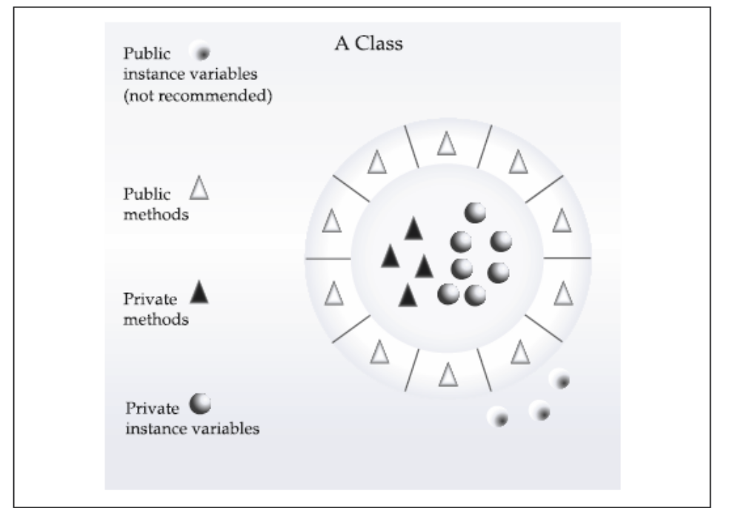

Slide 38
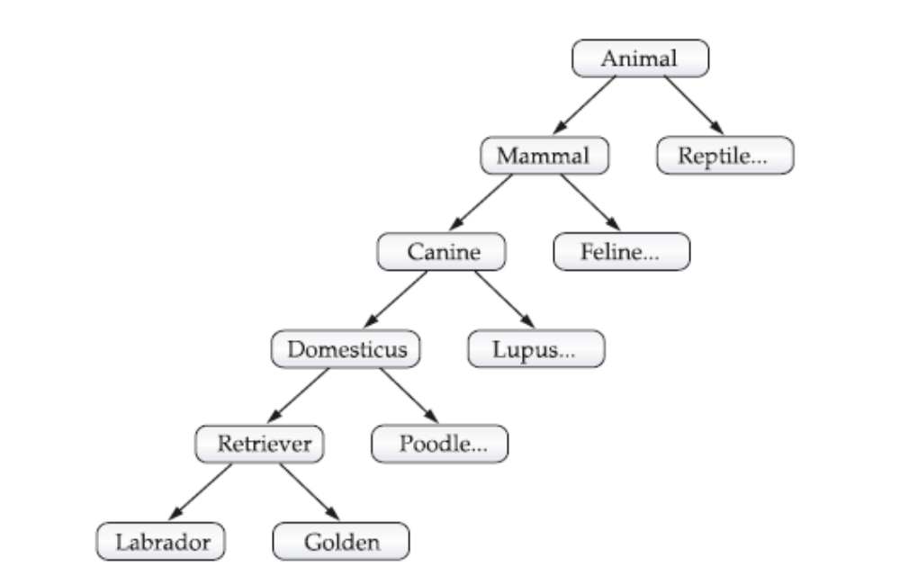

Slide 39
Polymorphism - is a feature that allows one interface to be used for a general class of actions. The specific action is determined by the exact nature of the situation.
Balanced use of these 3 principles in your program makes the program robust and scalable than process oriented program

